Slide 1
Pizza Sales Analysis
Swapnil Ranbhise

Slide 2
Overview
In the pizza sales analysis using MySQL Workbench, I examined key metrics to gain insights into sales performance. The analysis revealed the total number of orders placed and calculated the total revenue generated from these orders. We identified the highest priced pizza on the menu and determined which pizza was ordered most frequently. Additionally, the distribution of orders by hour of the day was analyzed, highlighting peak ordering times and much more queries are executed to gain further insights.

Slide 3

Retrieve the total number of orders placed?

Slide 4
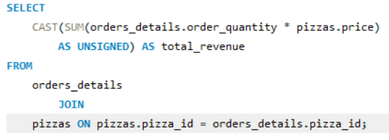

Calculate the total revenue generated from pizza sales?

Slide 5
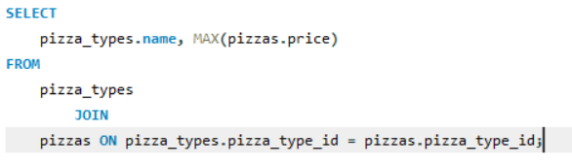

Identify the highest-priced pizza?

Slide 6
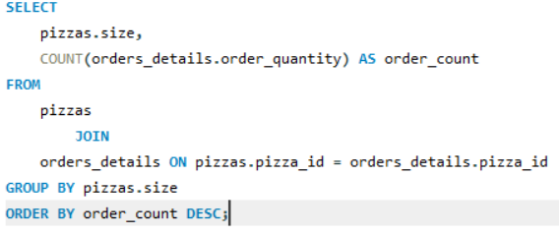
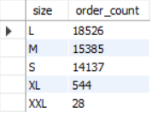
Identify the most common pizza size ordered?

Slide 7
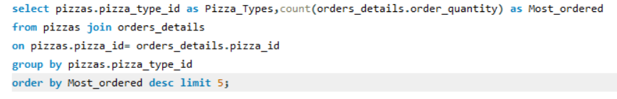
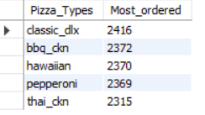
List the top 5 most ordered pizza types along with their quantities?

Slide 8
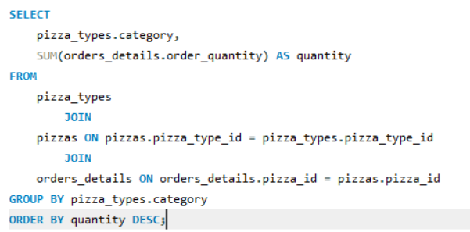
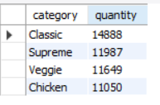
Join the necessary tables to find the total quantity of each pizza category ordered.

Slide 9
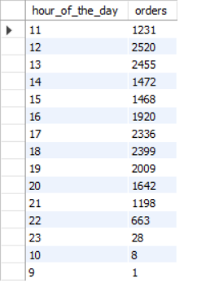
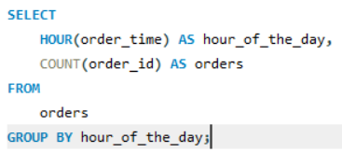
Determine the distribution of orders by hour of the day.

Slide 10

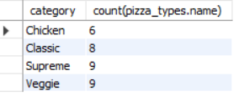
Join relevant tables to find the category-wise distribution of pizzas?

Slide 11
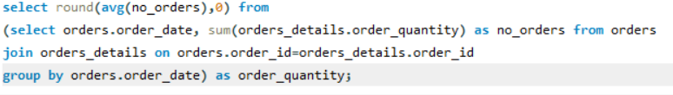

Group the orders by date and -- calculate the average number of pizzas ordered per day?

Slide 12
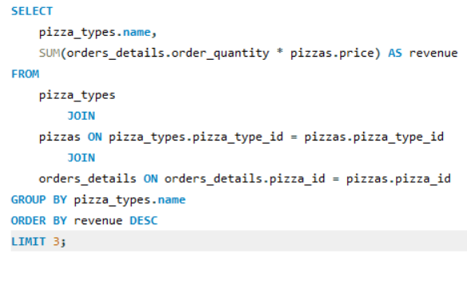

Determine the top 3 most ordered pizza types -- based on revenue?

Slide 13
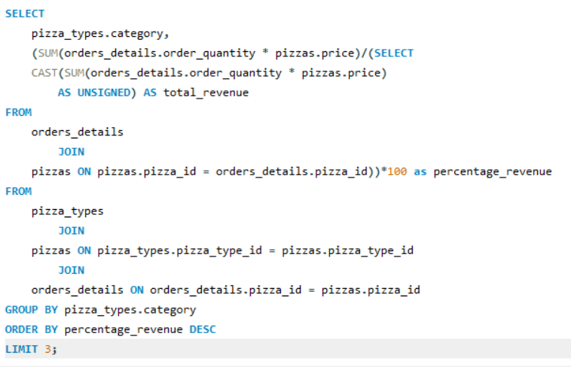
Calculate the percentage contribution of each pizza type to total revenue?

Slide 14


Slide 15
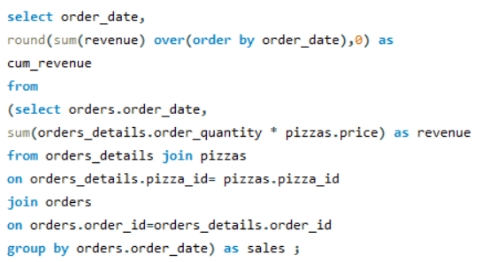
Analyze the cumulative revenue generated over time.

Slide 16
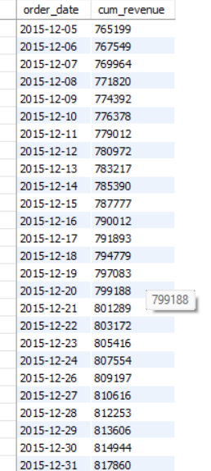
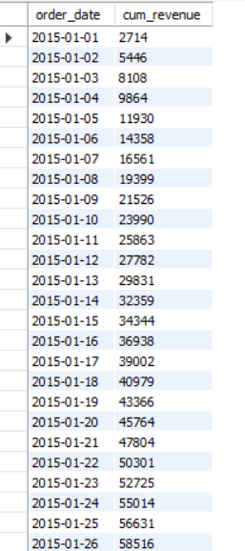

Slide 17
Thankyou.
The pizza sales analysis provided valuable insights into the business's performance. The total revenue and number of orders were quantified, with a clear trend of cumulative revenue growth over time. We identified the most and least popular pizzas, with specific contributions of each pizza type to the overall revenue. Peak ordering times were also highlighted, revealing crucial periods for maximizing sales. These findings can guide future marketing and operational strategies, focusing on popular pizza types and optimizing resources during peak hours to drive further revenue growth.

